Slide 1
Introduction
Sungjoon Choi
(sungjoon.choi@cpslab.snu.ac.kr)

Slide 2

Deep learning
RNN / LSTM
CNN
MLP
RBM

Slide 3
To tell the truth

Slide 4
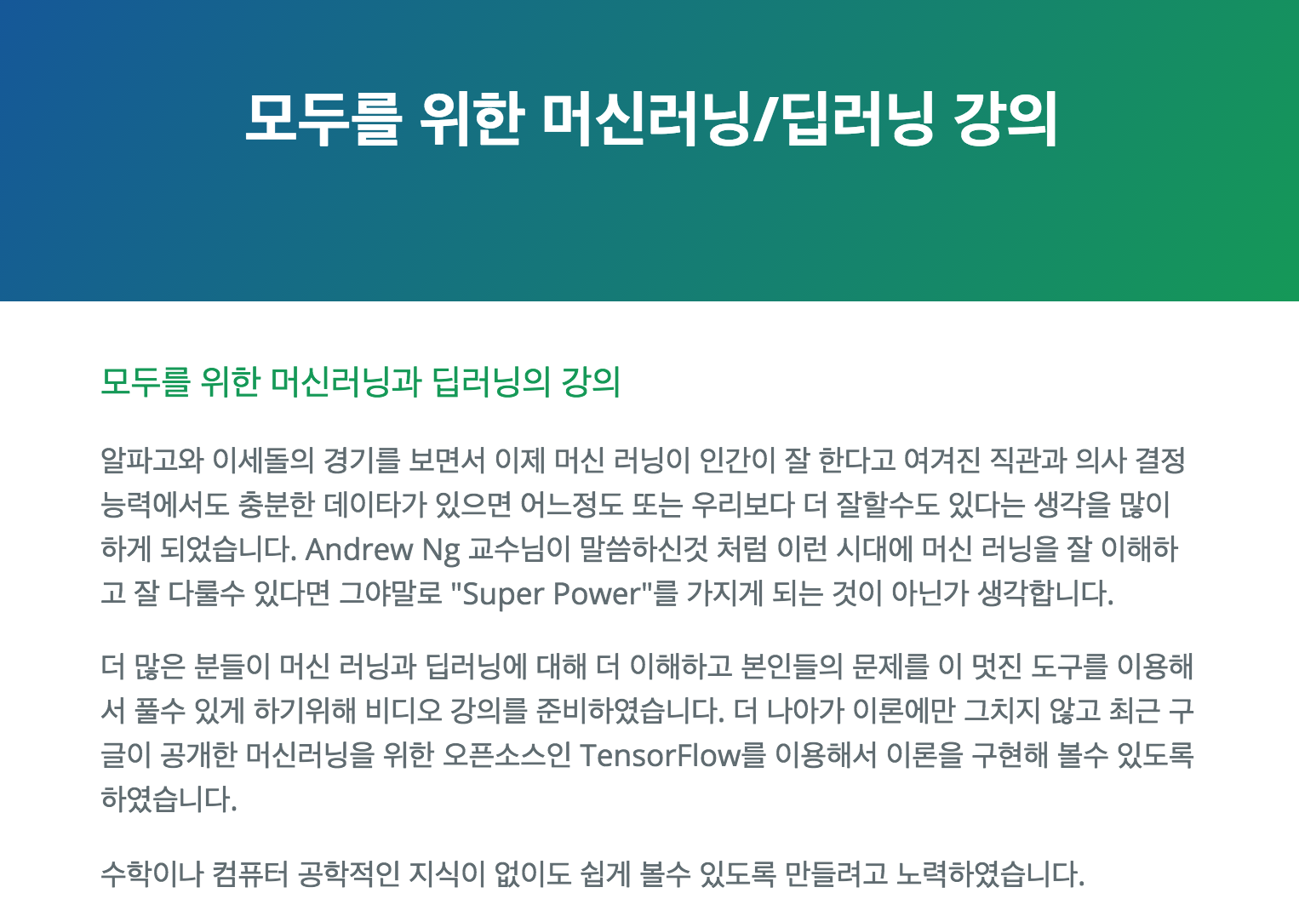
Deep learning tutorial
http://hunkim.github.io/ml/

Slide 5
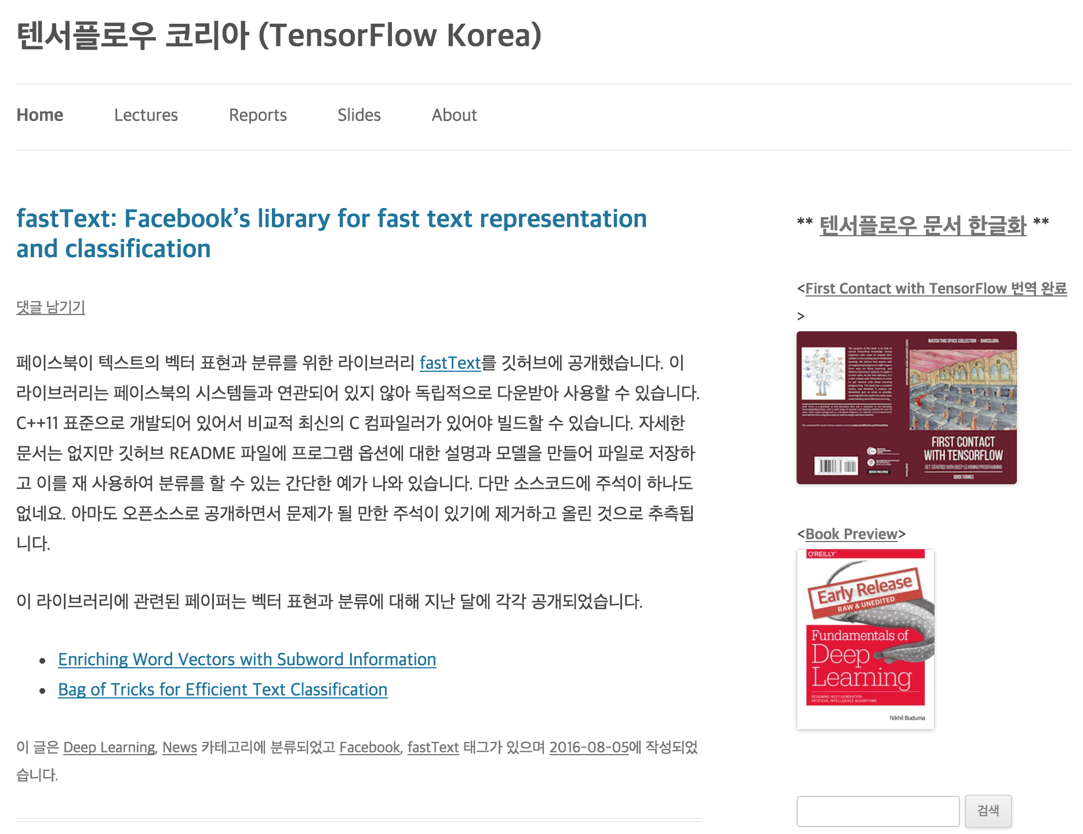
Deep learning tutorial
https://tensorflowkorea.wordpress.com

Slide 6
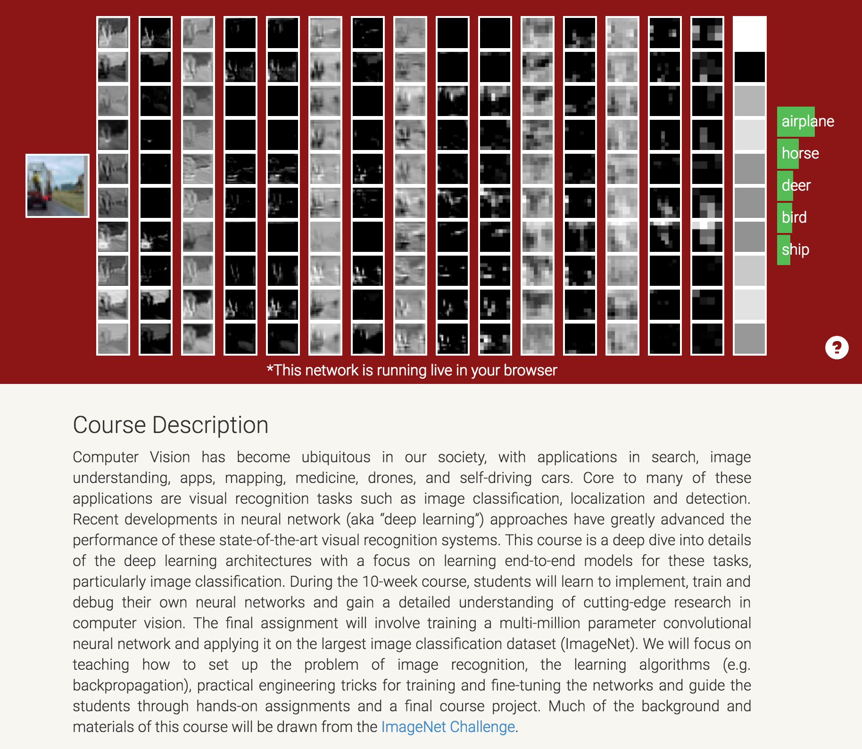
Deep learning tutorial
http://cs231n.stanford.edu/

Slide 7
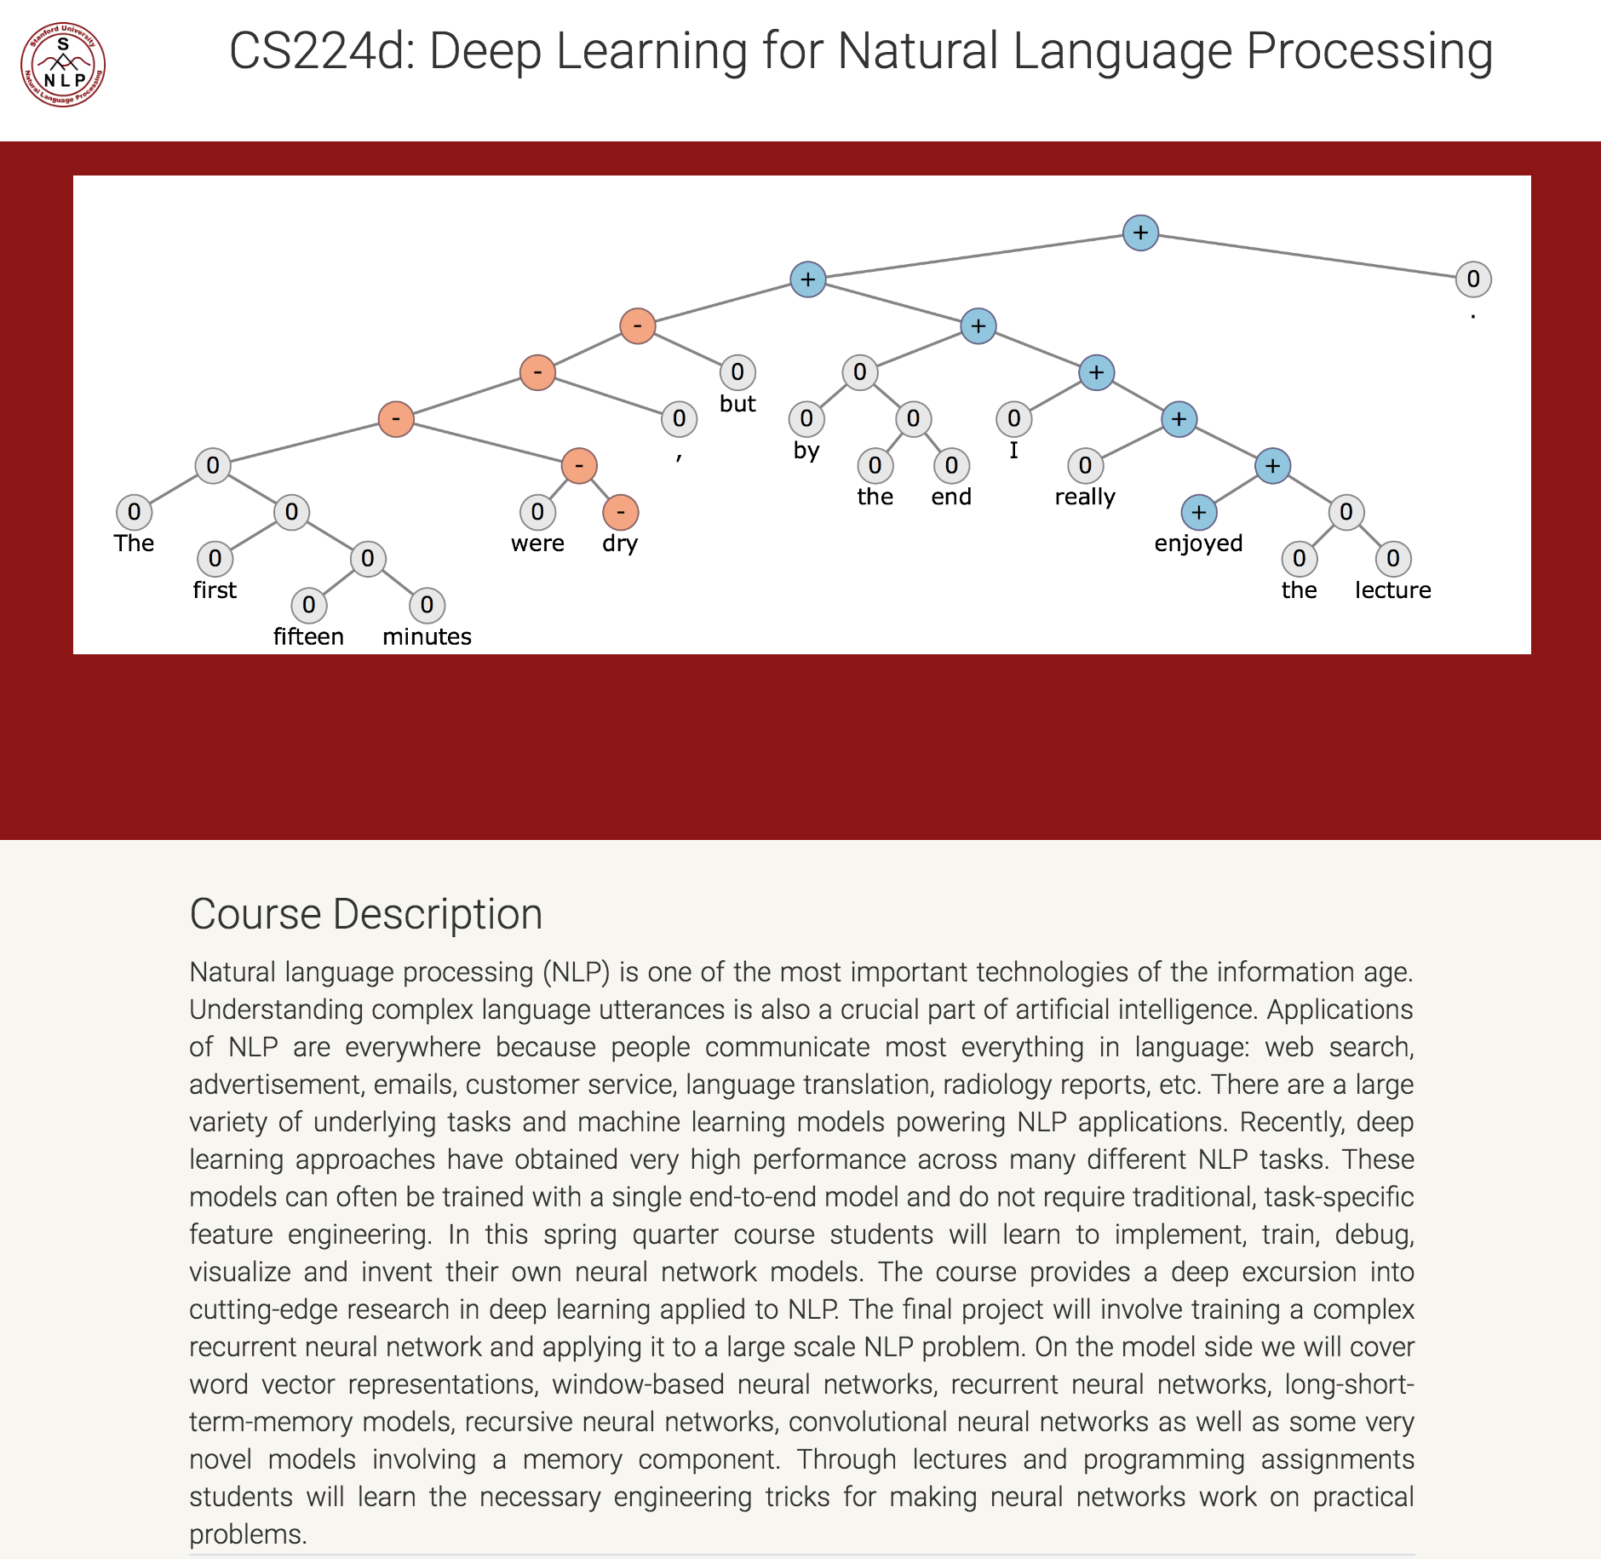
Deep learning tutorial
http://cs224d.stanford.edu/

Slide 8
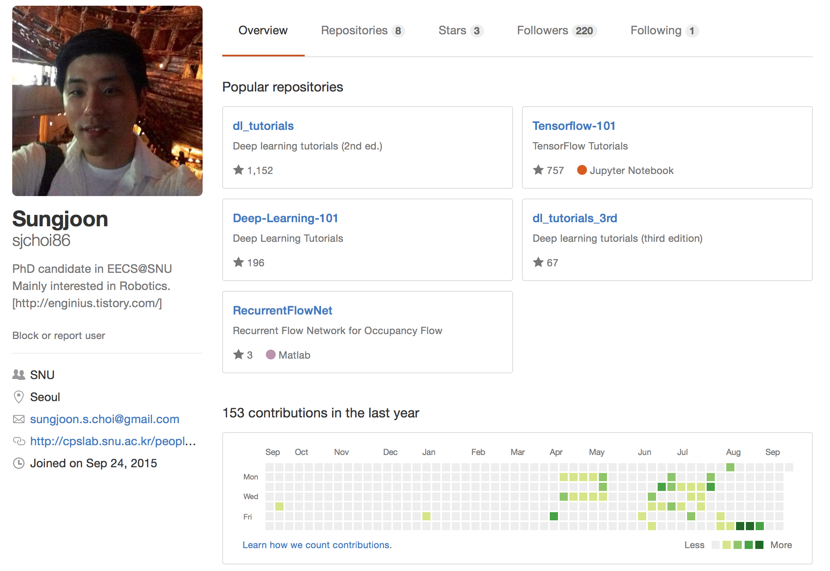
Deep learning tutorial
https://github.com/sjchoi86

Slide 9
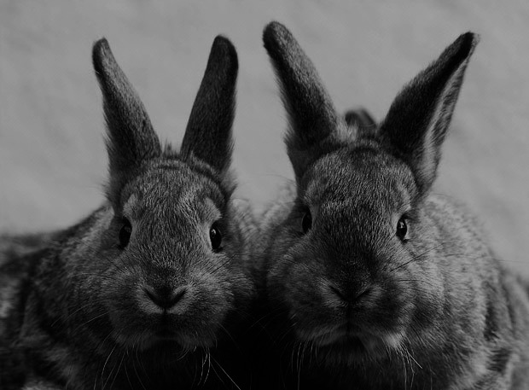
Goal
Deep Learning
Theories
TensorFlow
Implementation

Slide 10





SNS
?

Slide 11
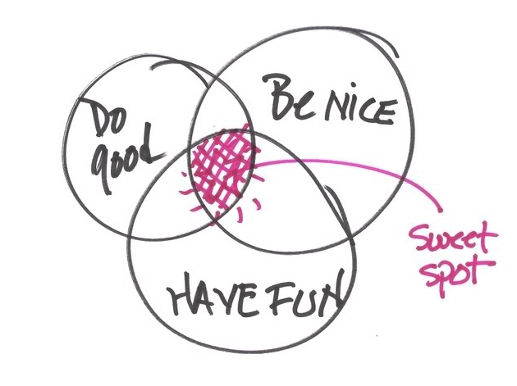
Importantly,

Slide 12

More importantly,

Slide 13
In this workshop, we will cover,

Slide 14
Outline
Basic Python usage
Basic image handling
Basic TensorFlow usage
Basic MNIST usage
Introduction to CNNs + Famous CNN architectures
Implementing Logistic Regression
Implementing Multi Layer Perceptron (MLP)
Implementing Convolutional Neural Network (CNN)
Implementing MLP and CNN with you OWN data
Appendix1: Semantic segmentation
Appendix2: Object detection
Appendix3: Visual question and answering
Appendix4: Generative adversarial networks

Slide 15
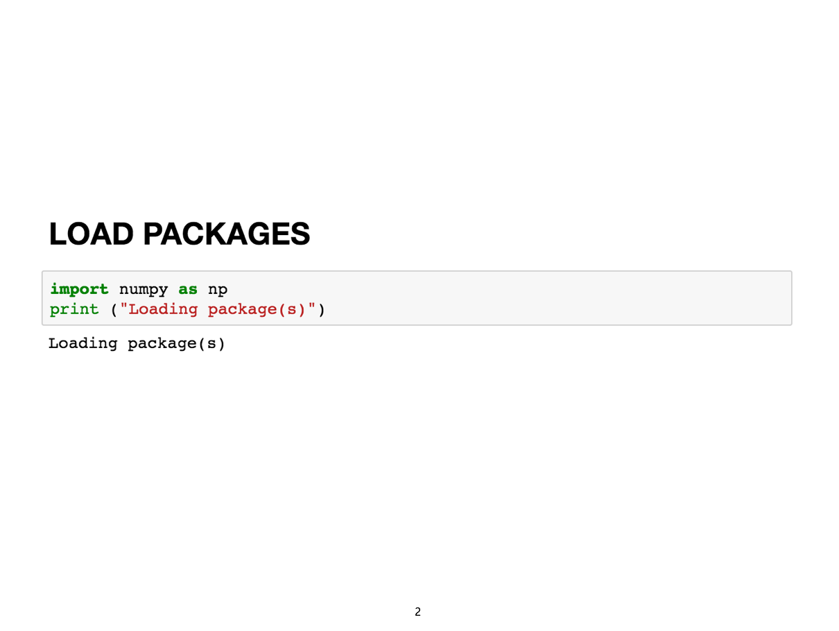
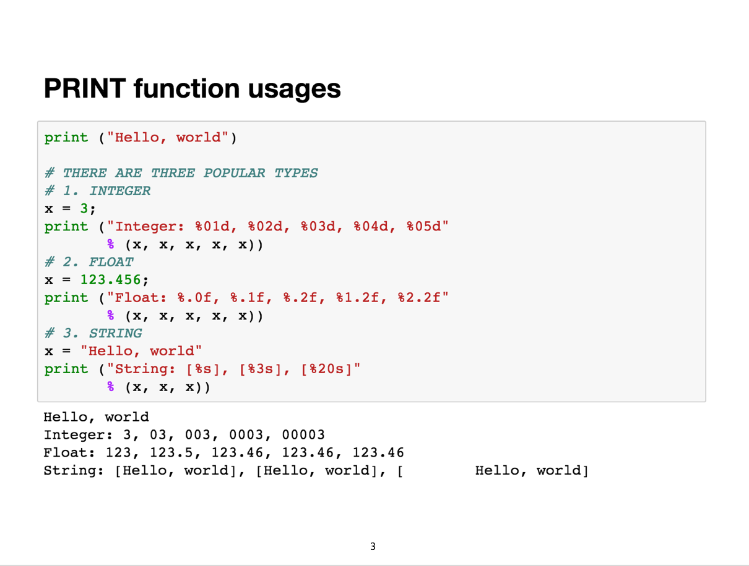
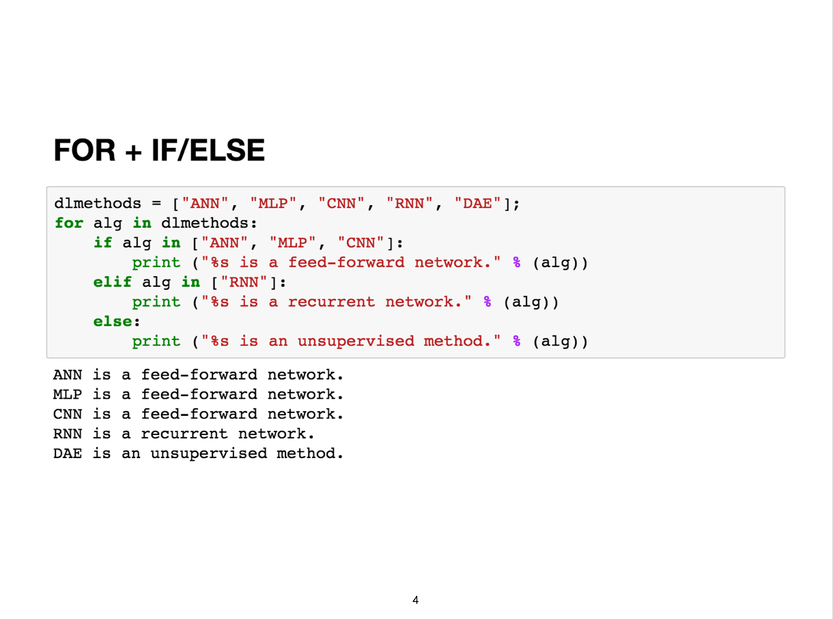
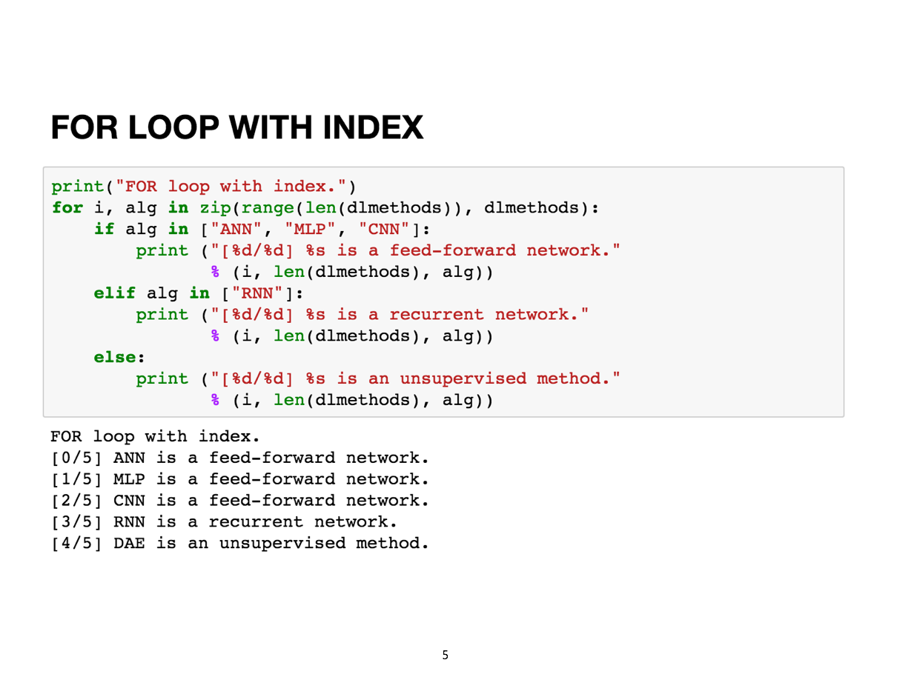
Basic Python usage

Slide 16
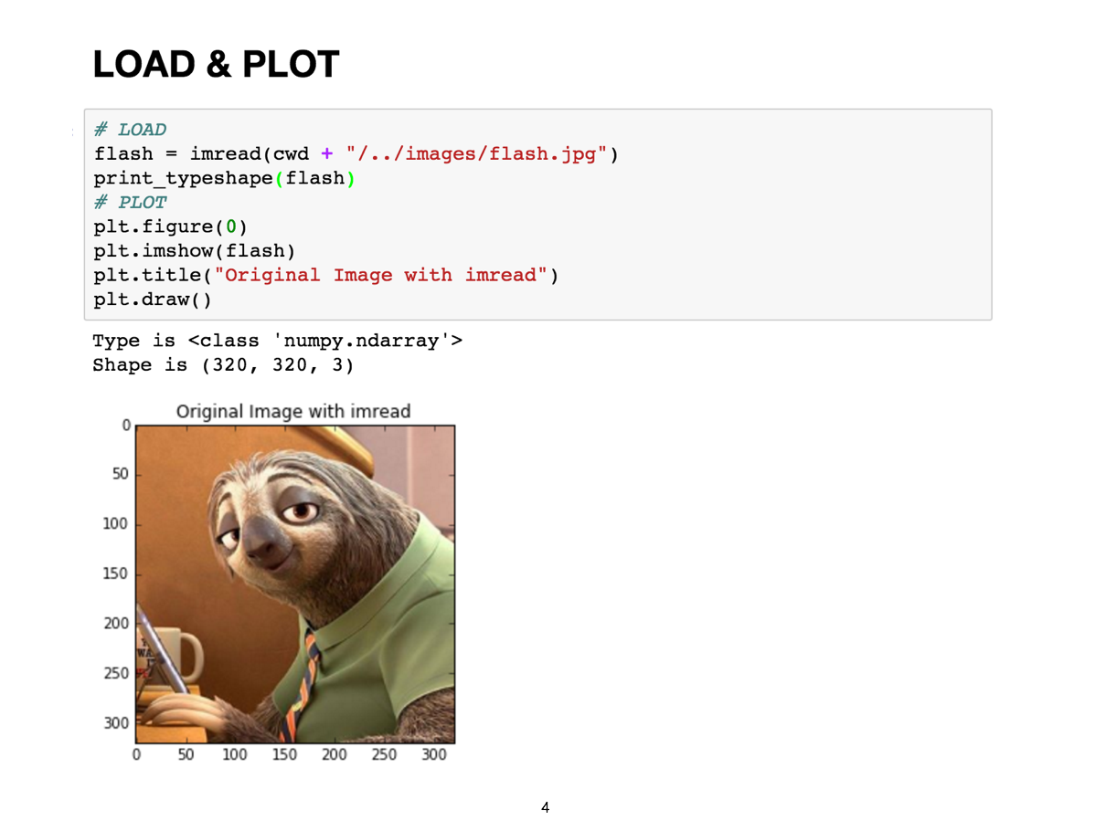
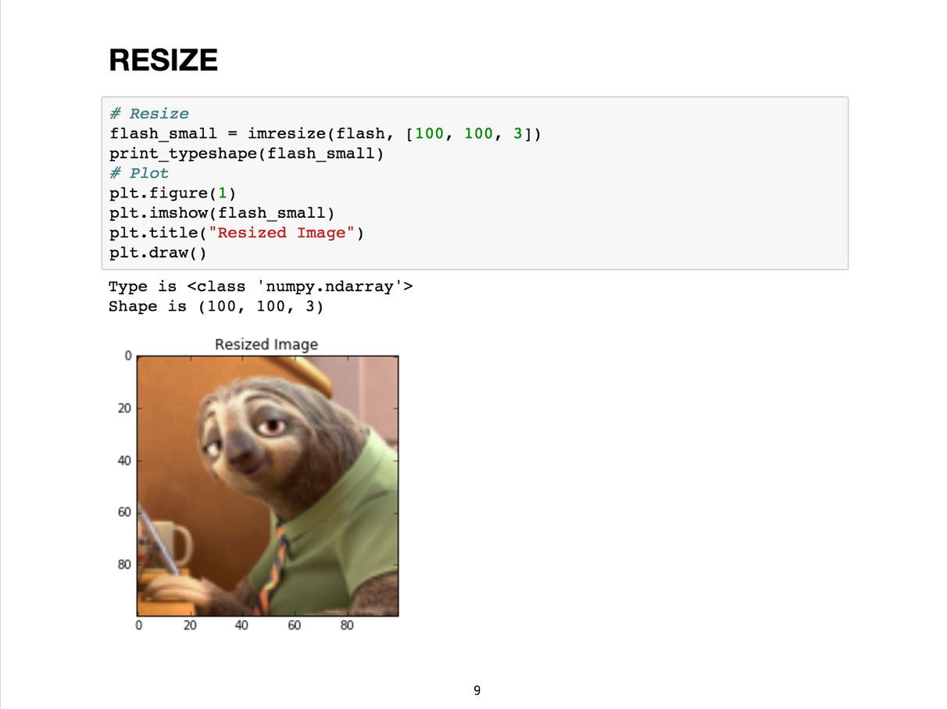
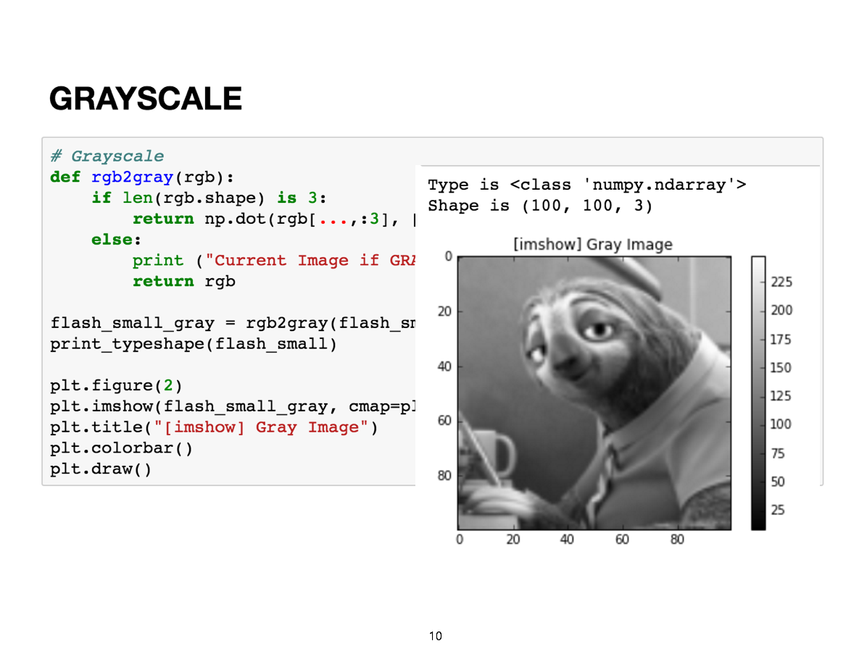
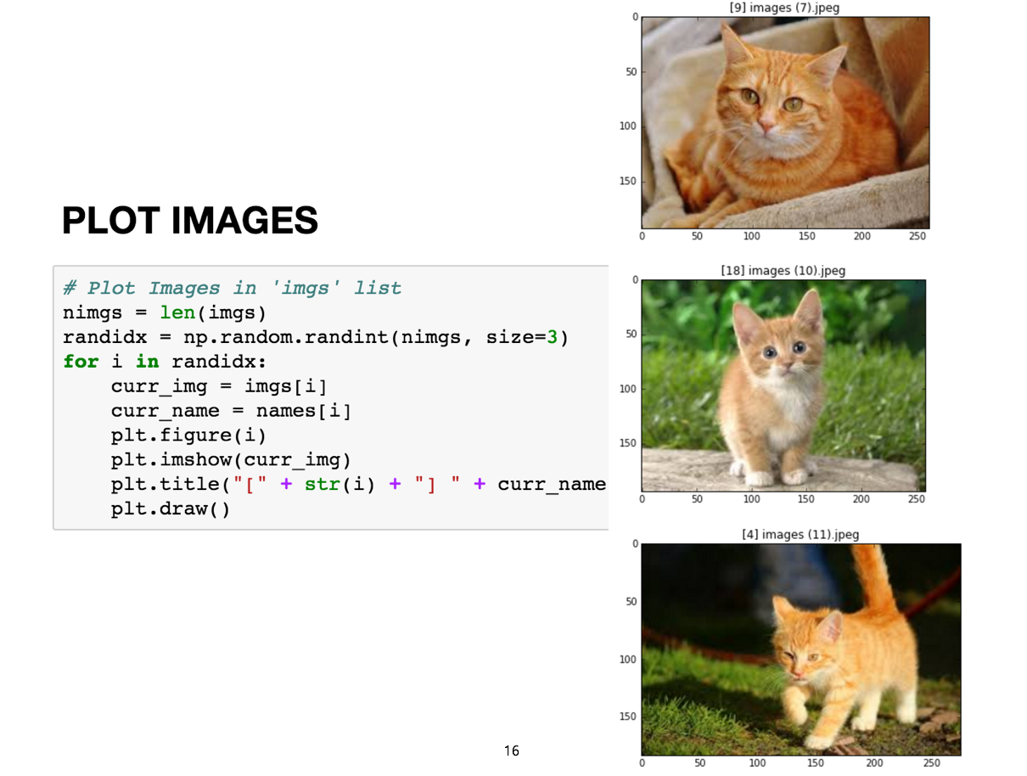
Image Handling

Slide 17
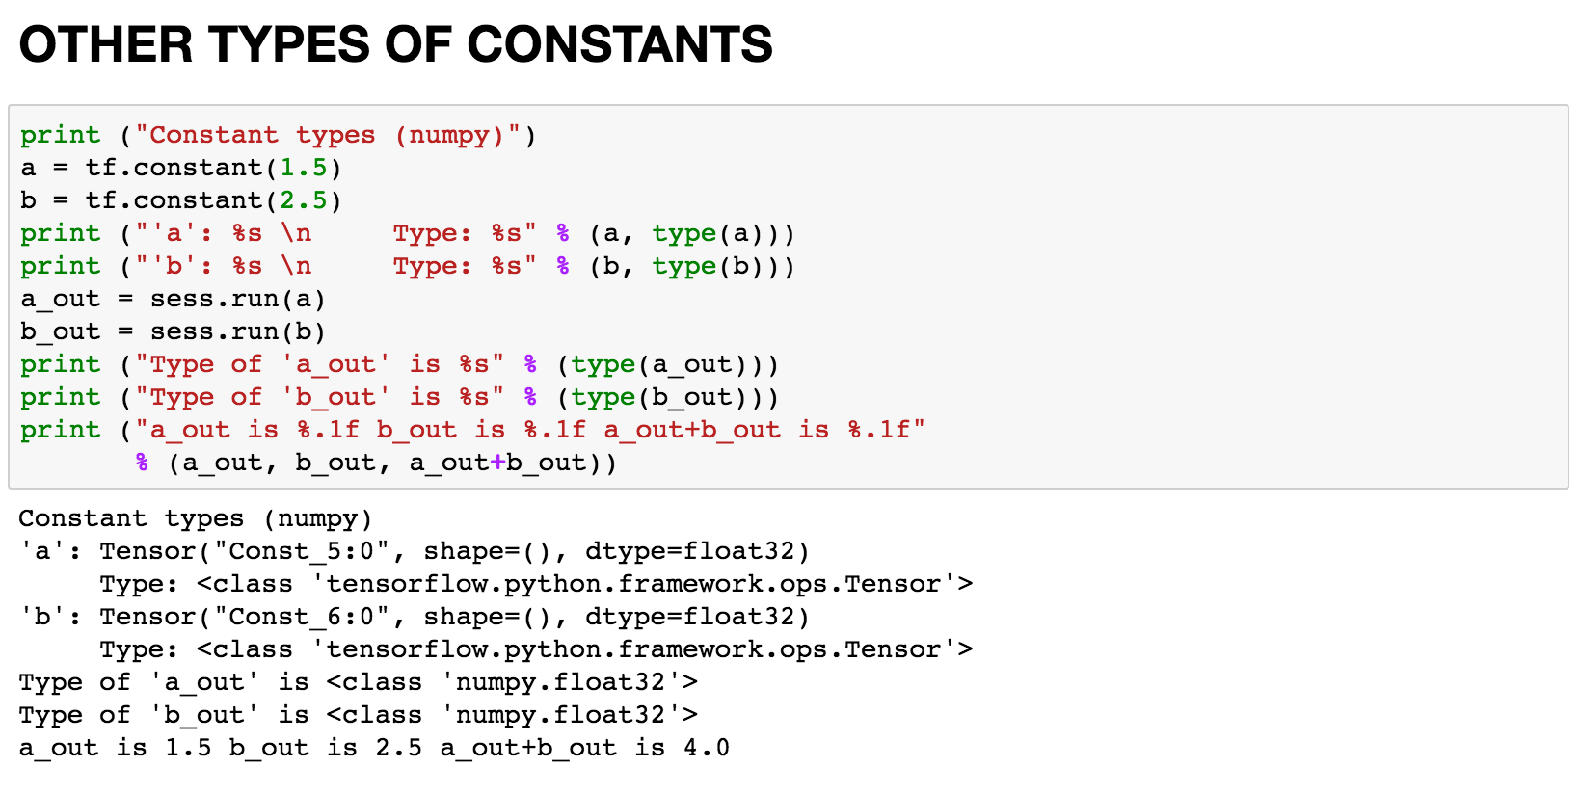
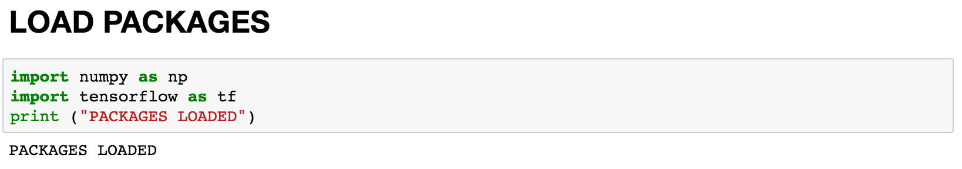
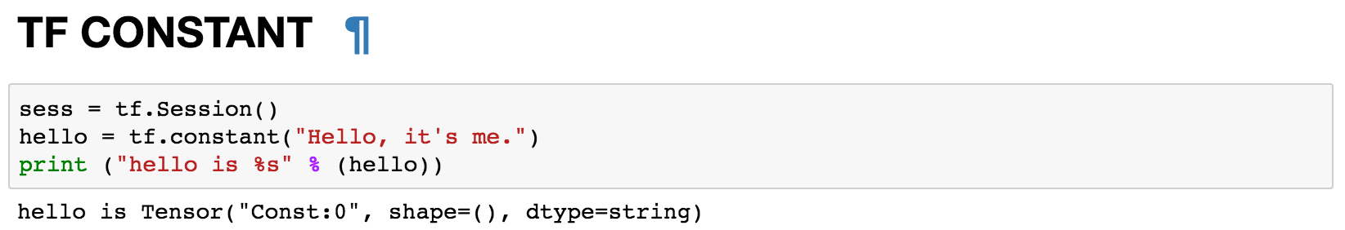
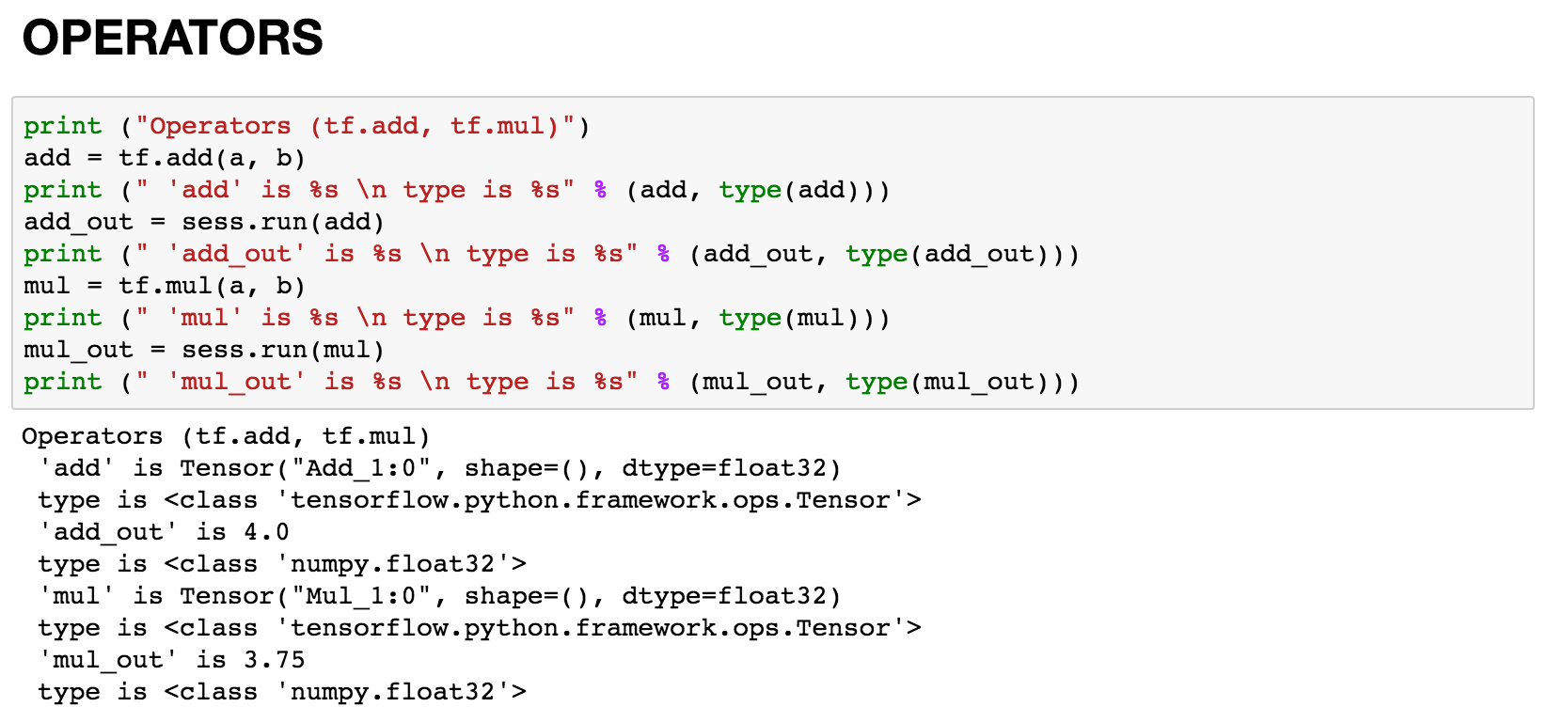
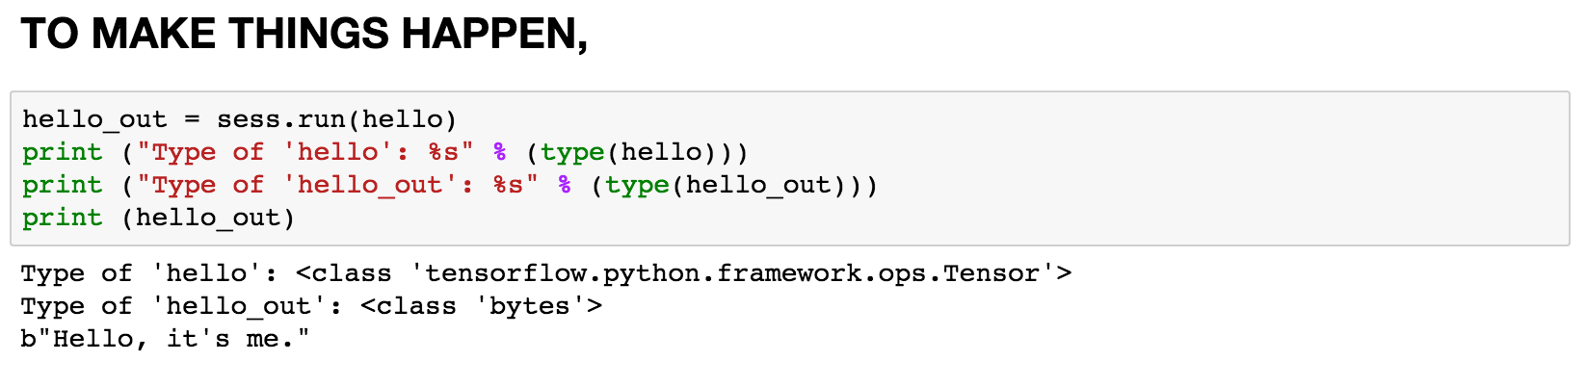
Basic TensorFlow

Slide 18
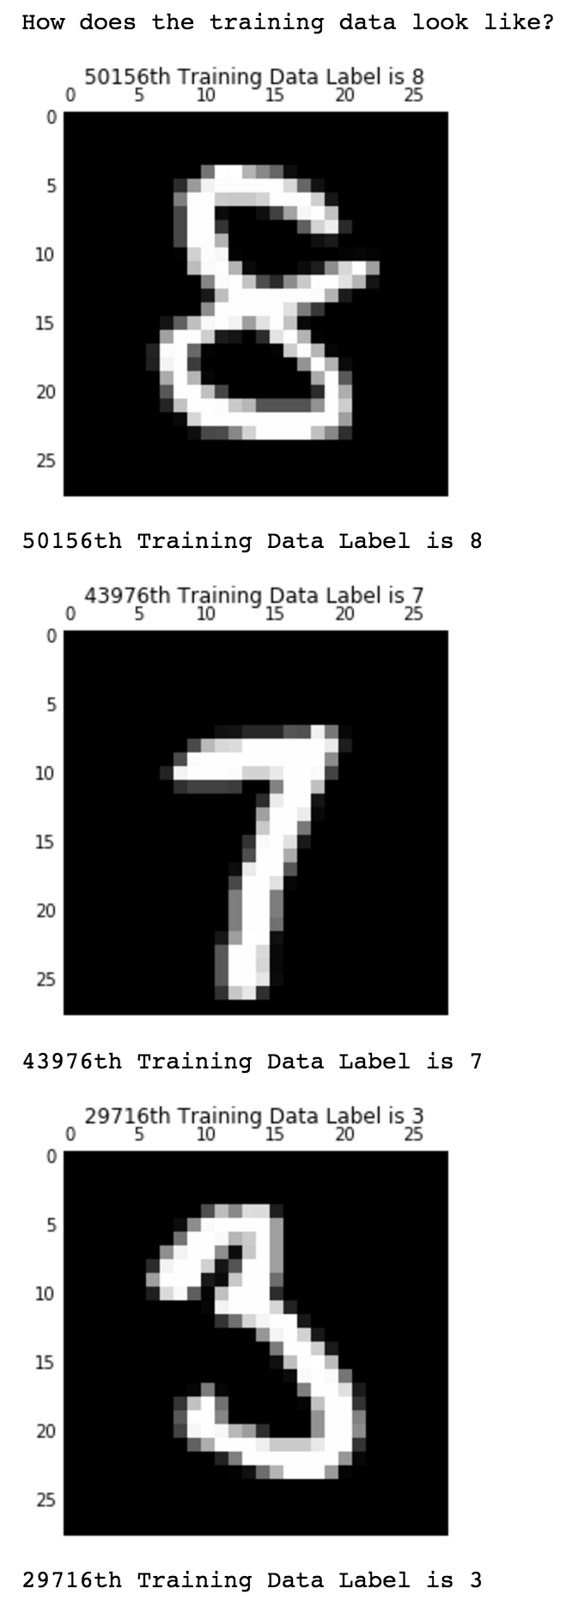
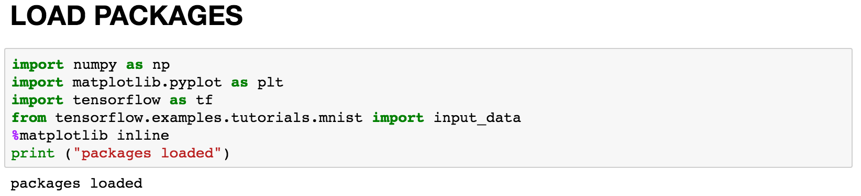
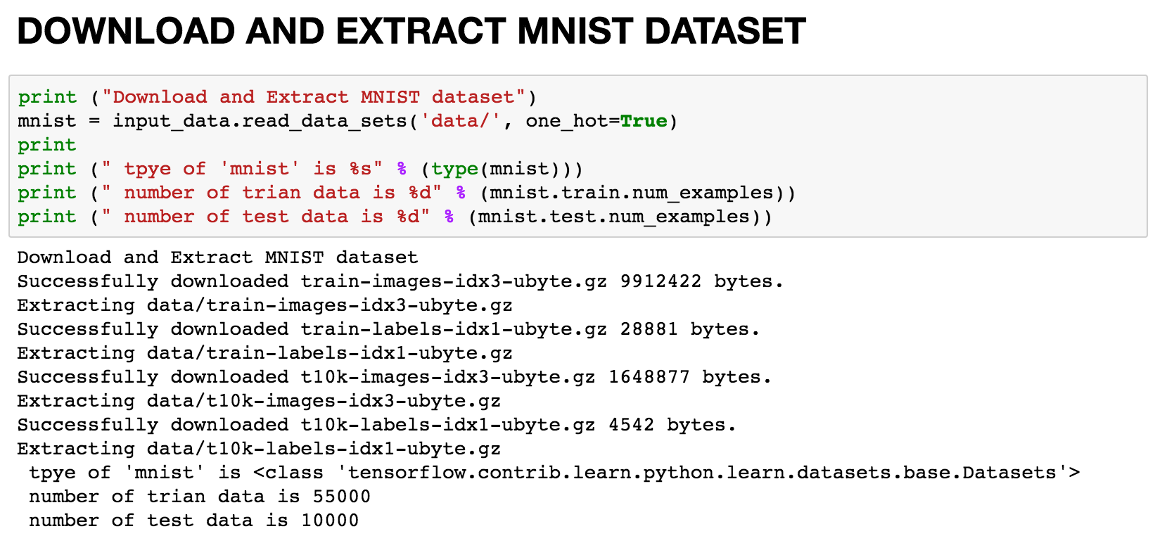
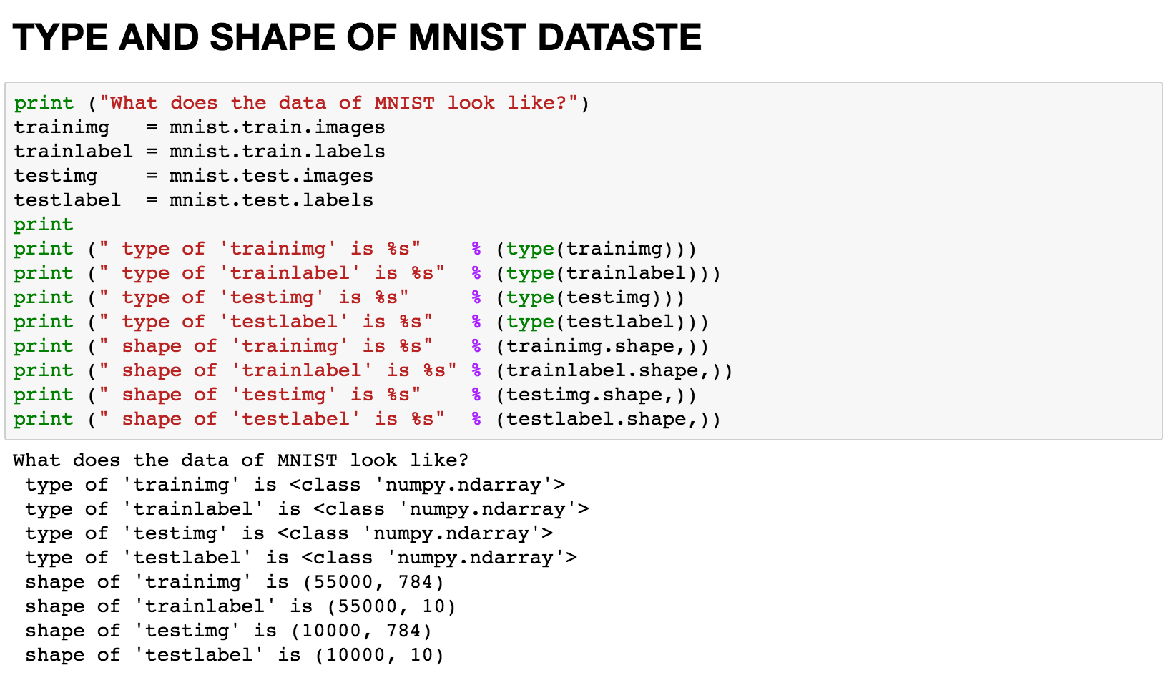
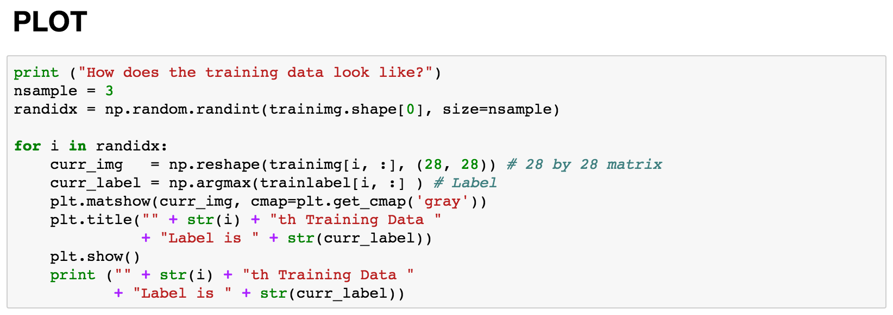
MNIST usage

Slide 19
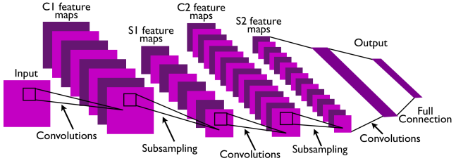

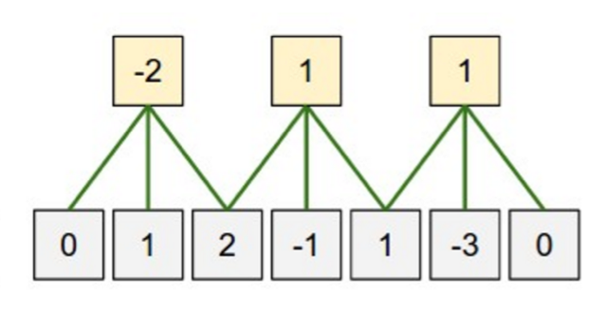
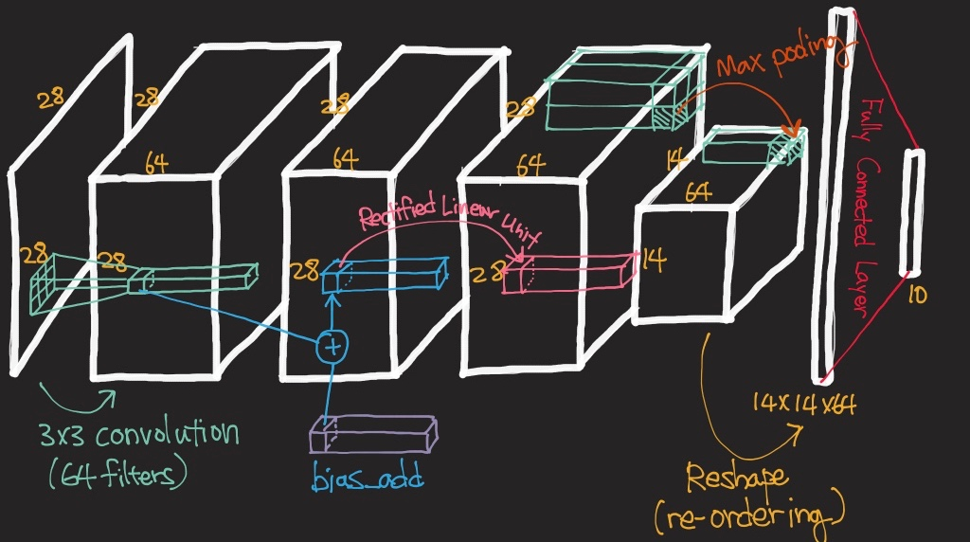
Convolutional Neural Network

Slide 20
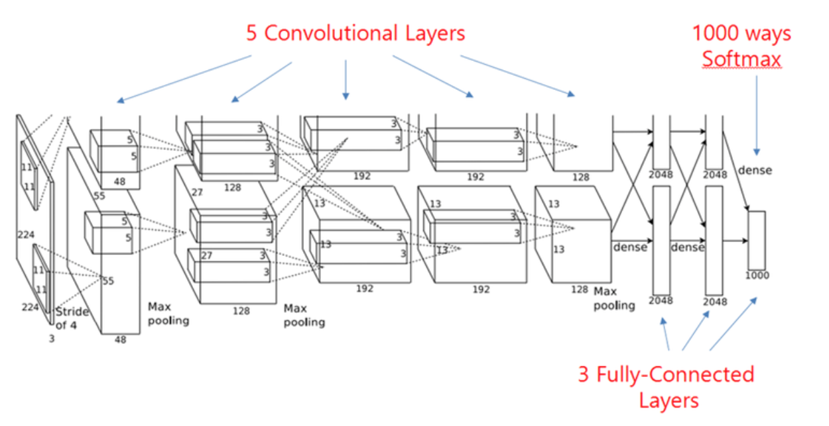
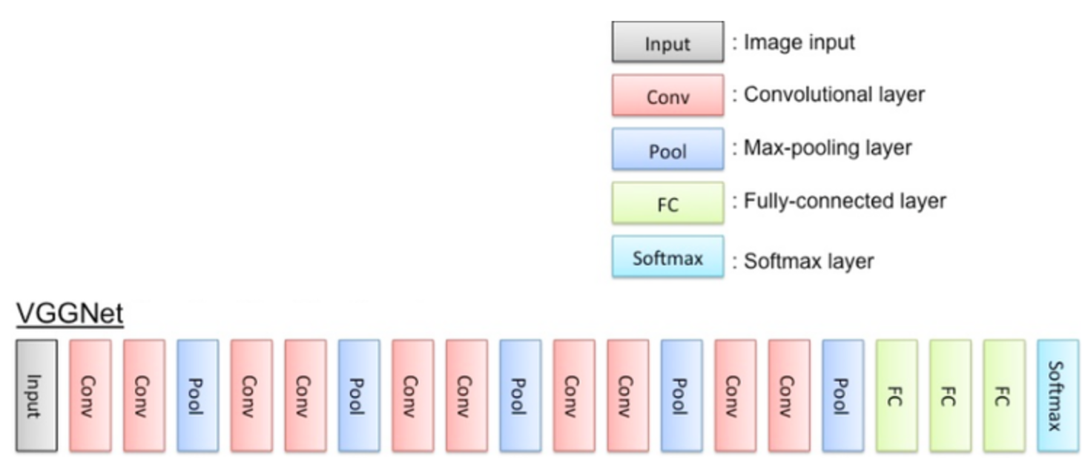
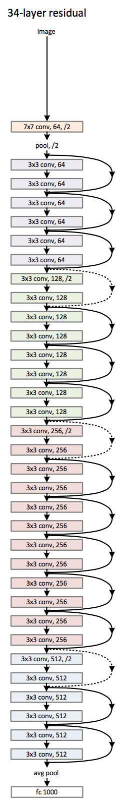
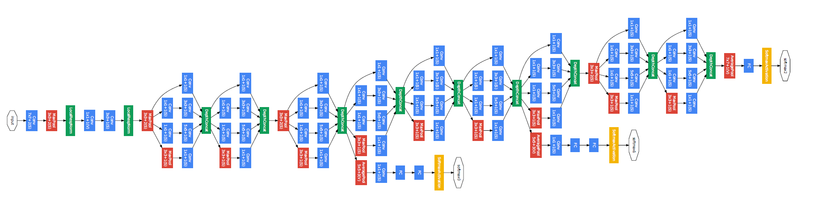
CNN Architectures
AlexNet
VGG
GoogLeNet
ResNet

Slide 21
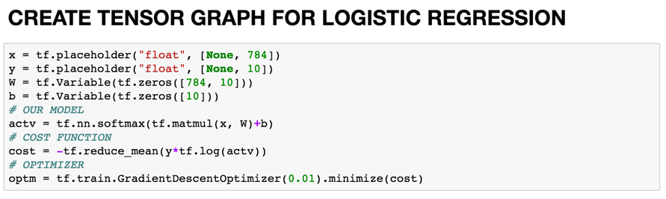
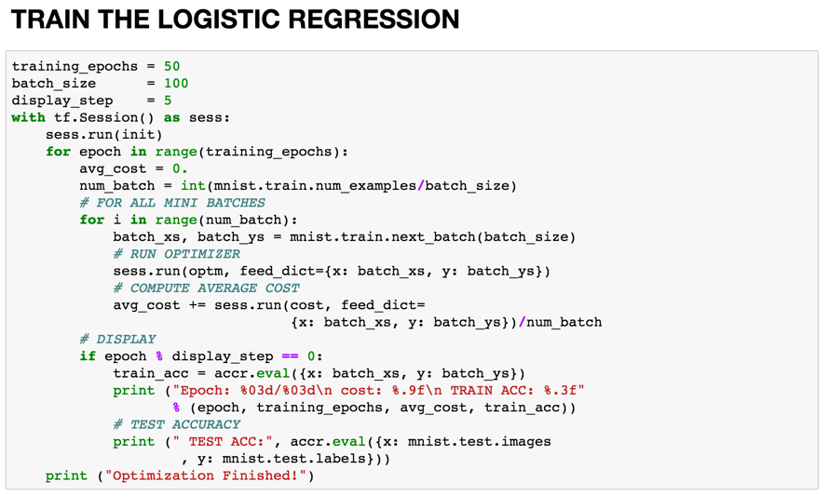
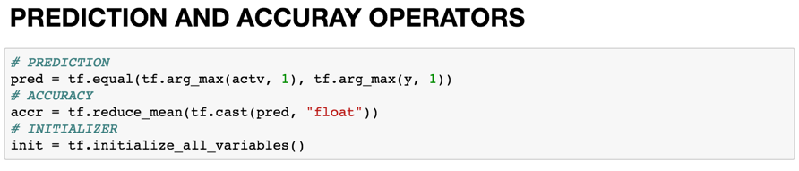
Implementing Logistic Regression

Slide 22
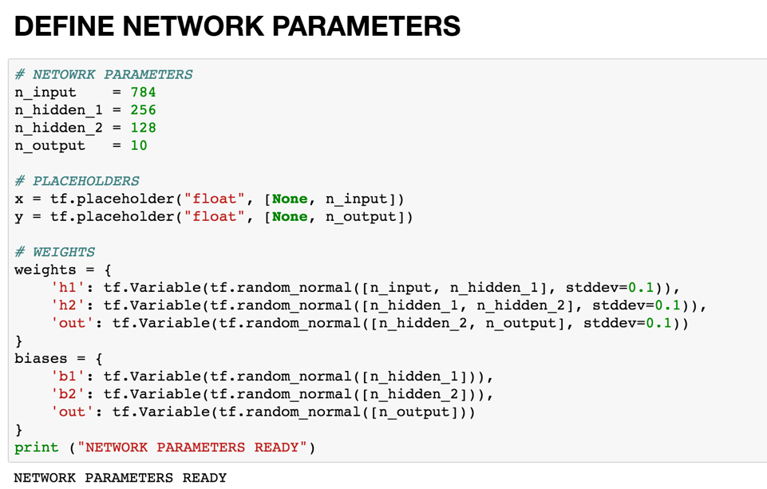
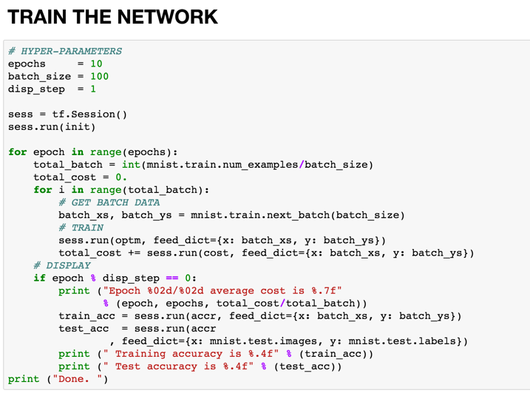
Implementing Multi Layer Perceptron

Slide 23
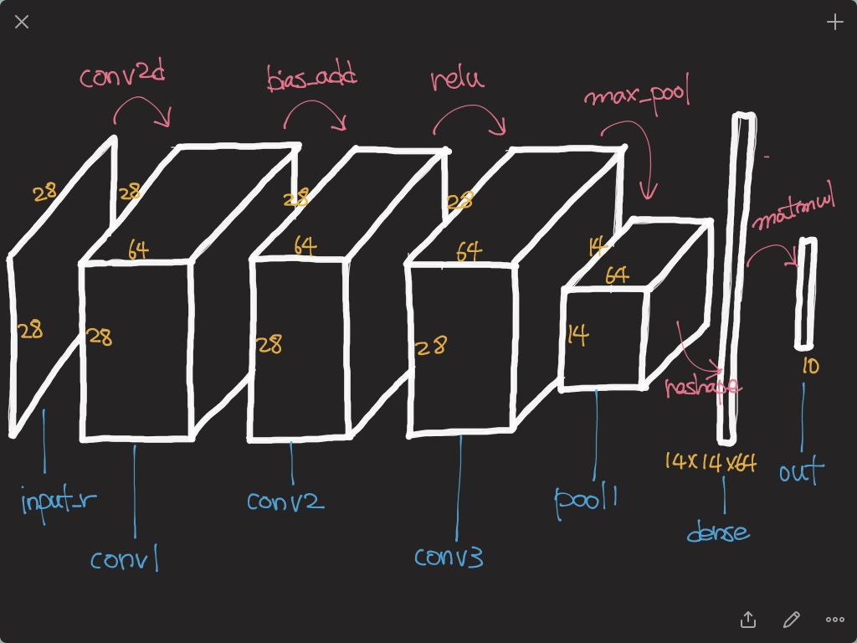
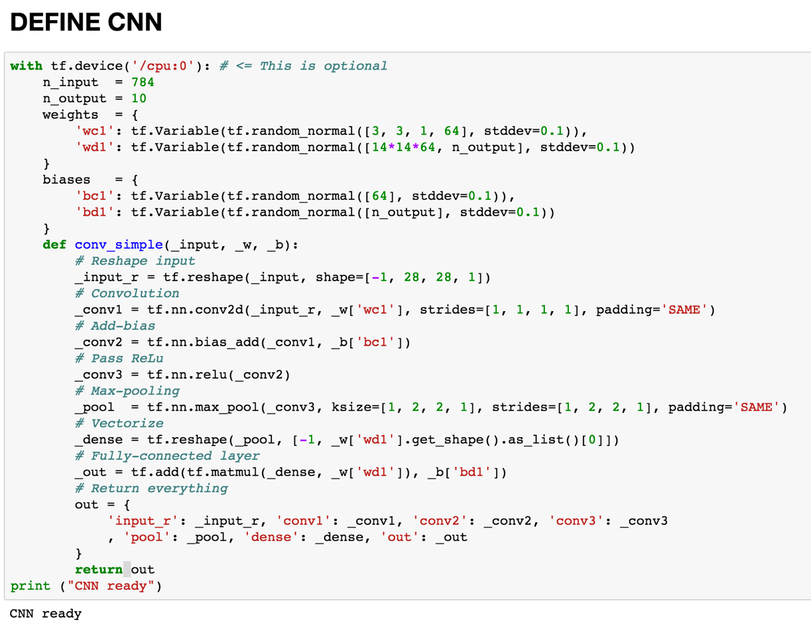
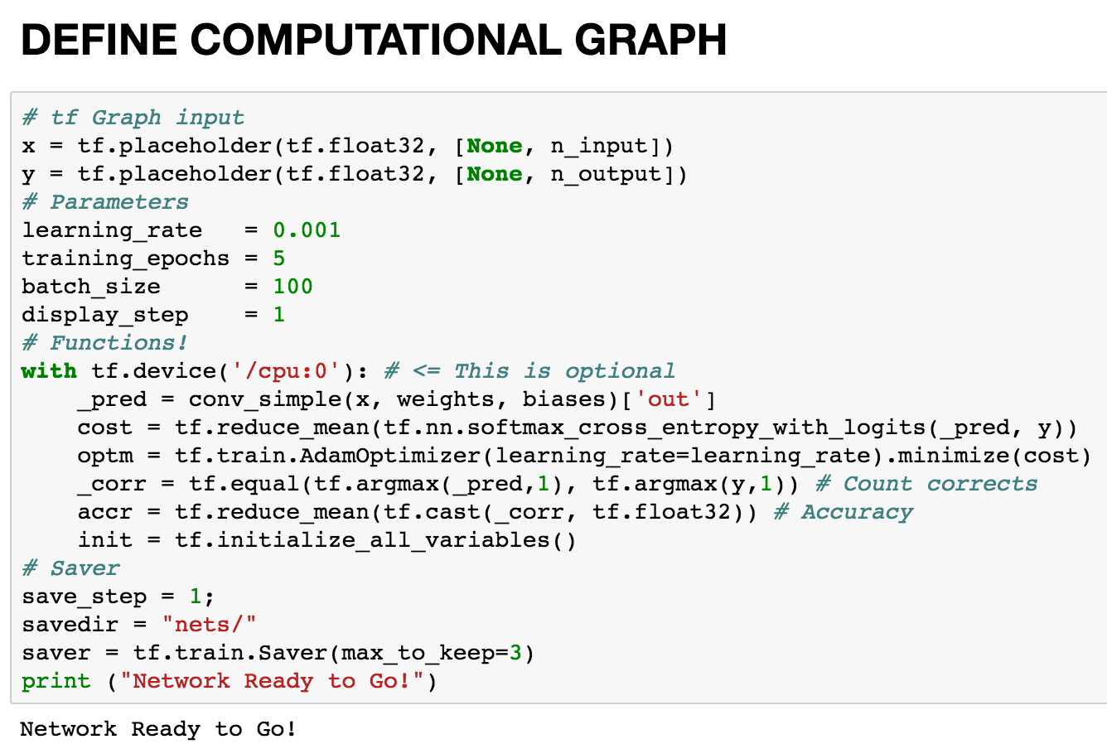
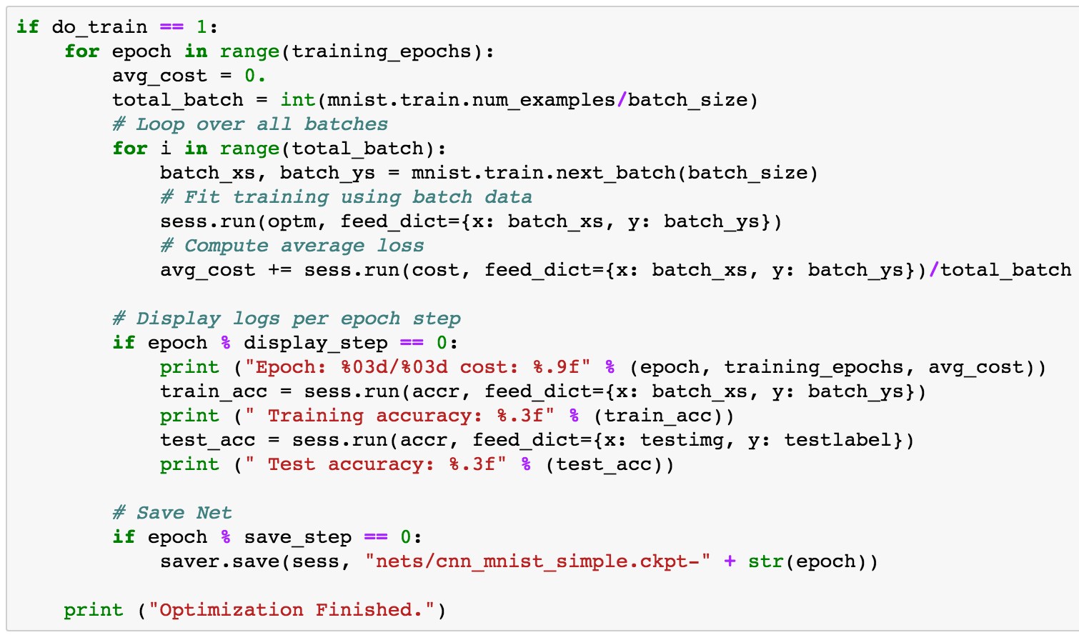
Implementing CNN

Slide 24
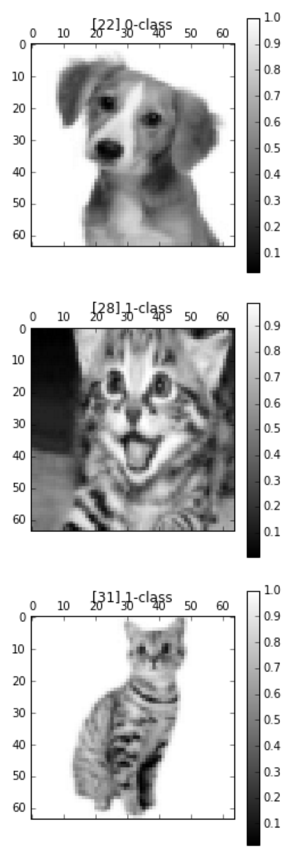
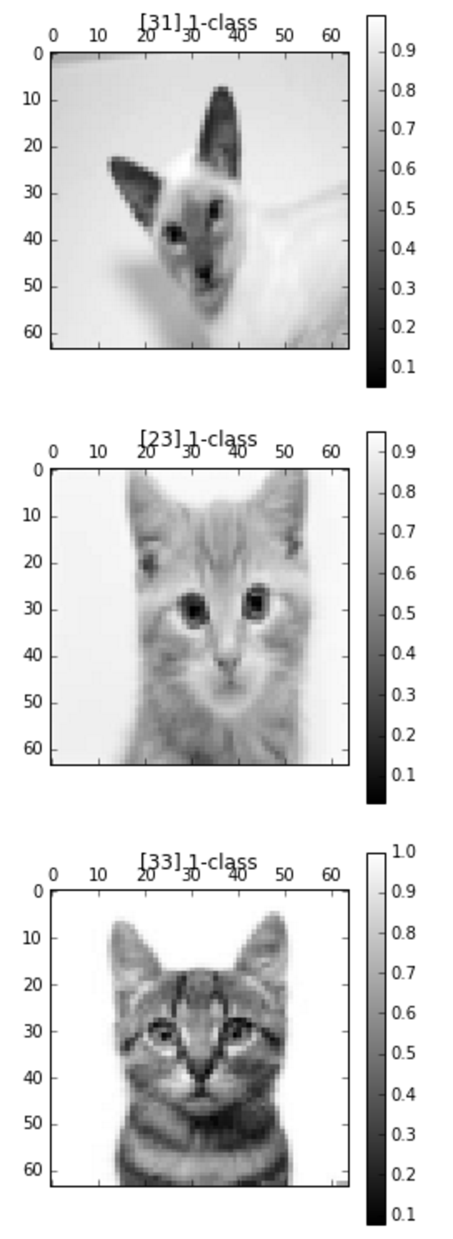
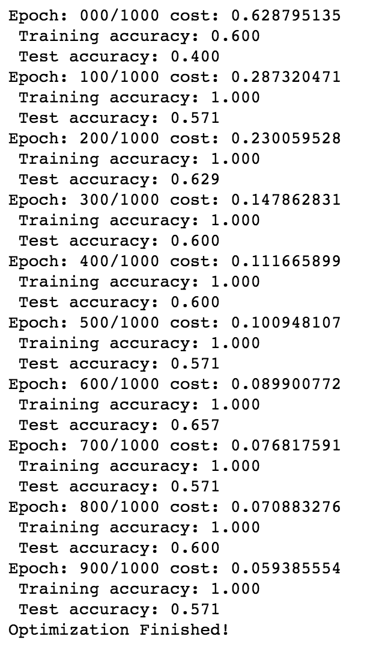
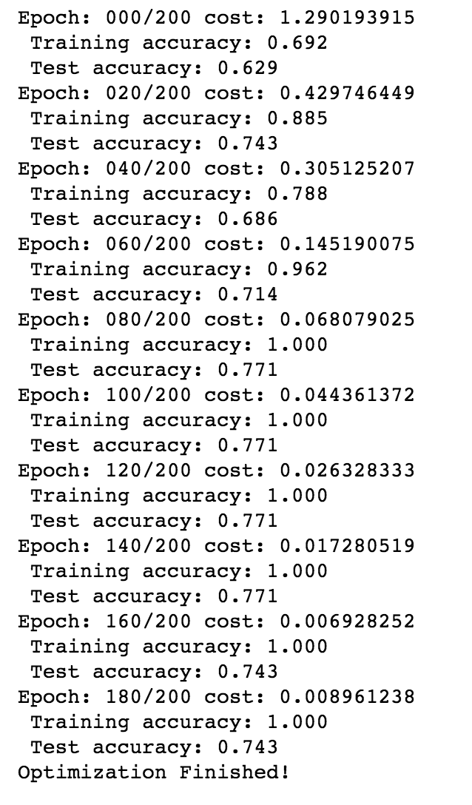
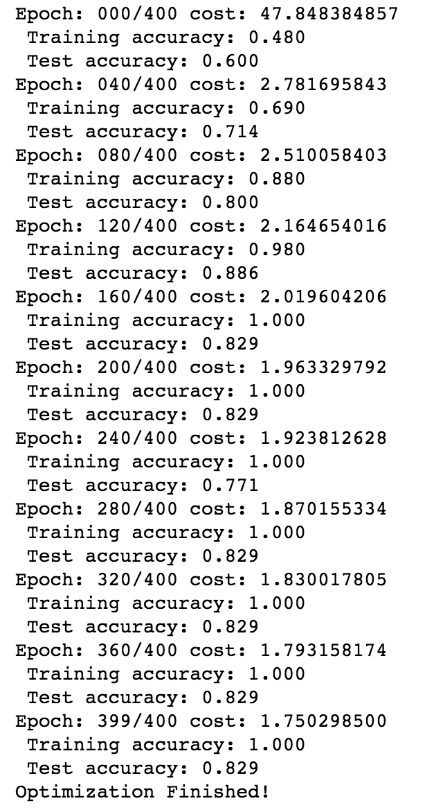
Training with a Custom dataset
LR
LR-tuned
MLP
CNN

Slide 25
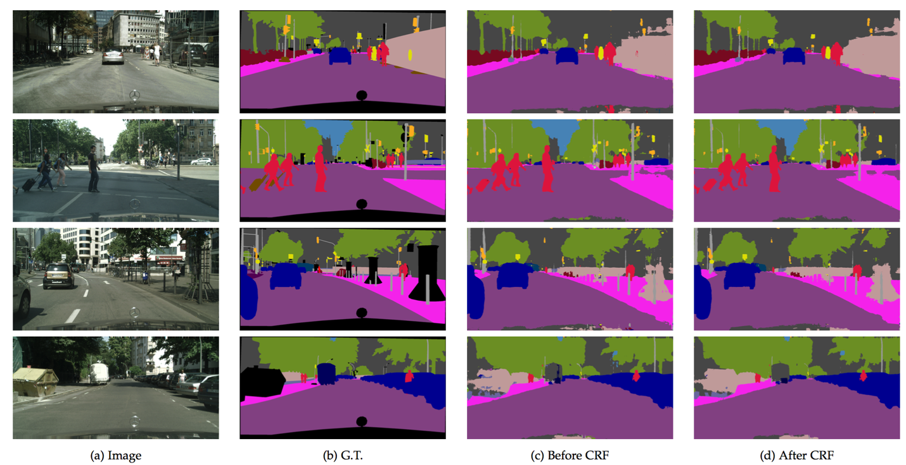
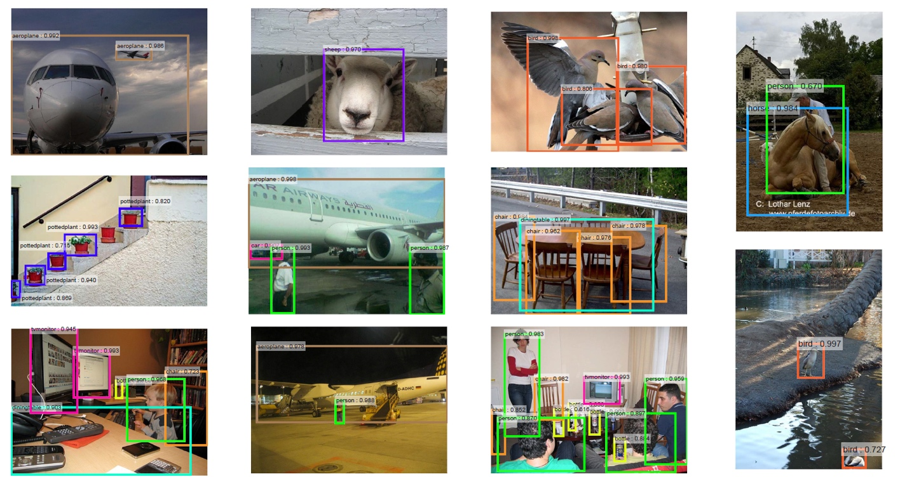
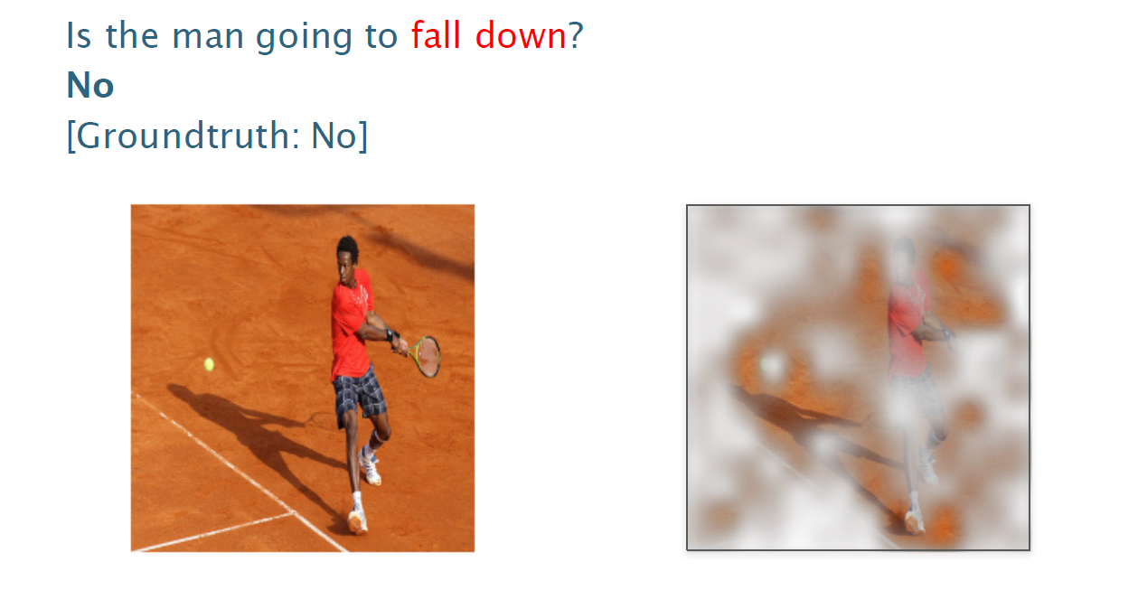
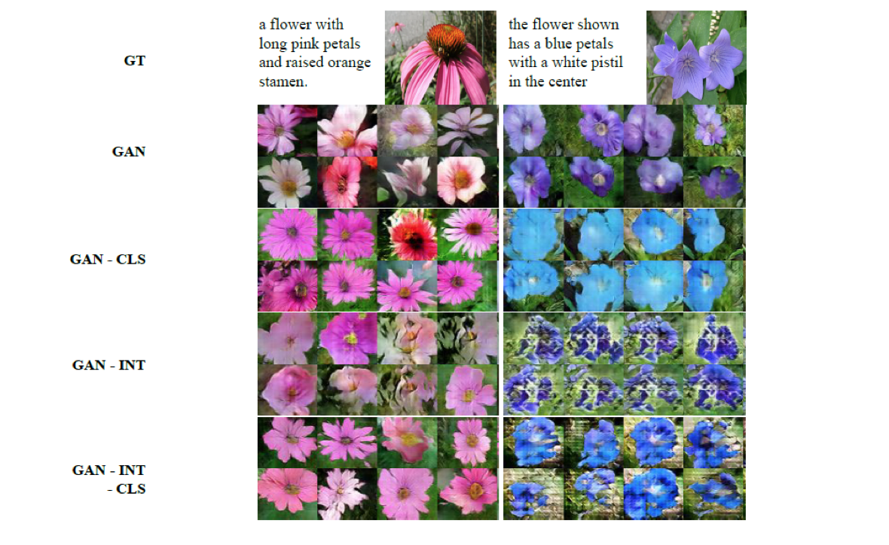
And if time permits,
Semantic Segmentation
Object Detection
Visual QnA
Generative Adversarial Network

Slide 26


Caution

Slide 27
Deep learning theories covers, (in my original course)

Slide 28

Convolutional neural network
AlexNet
GoogleLeNet

Slide 29





Algorithms behind AlphaGo
Rollout net
Value net
RL net
SL Policy Network

Slide 30

Regularization
Main purpose is to avoid “OverFitting”

Slide 31


Optimization methods

Slide 32

Restricted Boltzmann machine

Slide 33
Denoising auto-encoder

Slide 34

Semantic segmentation

Slide 35

Weakly-supervised localization

Slide 36




Object Detection
R-CNN
SPP net
Fast R-CNN
Faster R-CNN

Slide 37

RNN - LSTM
Output
Forget Gate
(Cell) state
Next (Cell) State
Input Gate
Output Gate
Hidden State
Next Hidden State
Input
Output = Hidden state
37
http://colah.github.io/posts/2015-08-Understanding-LSTMs/

Slide 38

Visual Q&A

Slide 39

Super resolution

Slide 40

Deep reinforcement learning

Slide 41

Handwriting generation

Slide 42
Word embedding

Slide 43

Image captioning

Slide 44

Hangul-RNN

Slide 45


Residual Network & analyses
Dimension reduction
Convolution
Dimension increasement

Slide 46



Neural Style
Texture Synthesis Using Convolutional Neural Networks
NIPS2015
Understanding Deep Image Representations by Inverting Them
CVPR2015

Slide 47



Generative adversarial networks

Slide 48
Deep learning implementations cover, (in my original course)

Slide 49



Basic Python

Slide 50

Using MNIST

Slide 51



Basic image handling

Slide 52
Basic TensorFlow
Computational Graph (TensorFlow)
Optimizer
Loss
Operation
Variable
PlaceHolder

Slide 53

Logistic regression

Slide 54

Multi-layer perceptron

Slide 55

Generating own datasets

Slide 56

Denoising auto-encoder

Slide 57


Convolutional neural network

Slide 58


Semantic segmentation

Slide 59


TensorBoard

Slide 60

Multi-to-one RNN

Slide 61

Word2vec

Slide 62

Char-RNN

Slide 63




Neural style

